Slide 1
Trend trading
Turtle strategy

Slide 2
Data
Portfolio: AUDUSD, EURUSD , GBPUSD , NZDUSD , USDCAD , USDCHF , USDJPY , USDNOK , USDSEK , USDBRL , USDCLP , USDCOP , USDCZK , USDHUF, USDILS , USDINR , USDKRW , USDMXN , USDMYR , USDPHP , USDPLN , USDRON , USDSGD , USDTHB , USDTRY , USDTWD , USDZAR
Backtest period: 11-Apr-2002 to 31-Jan-2020

Slide 3
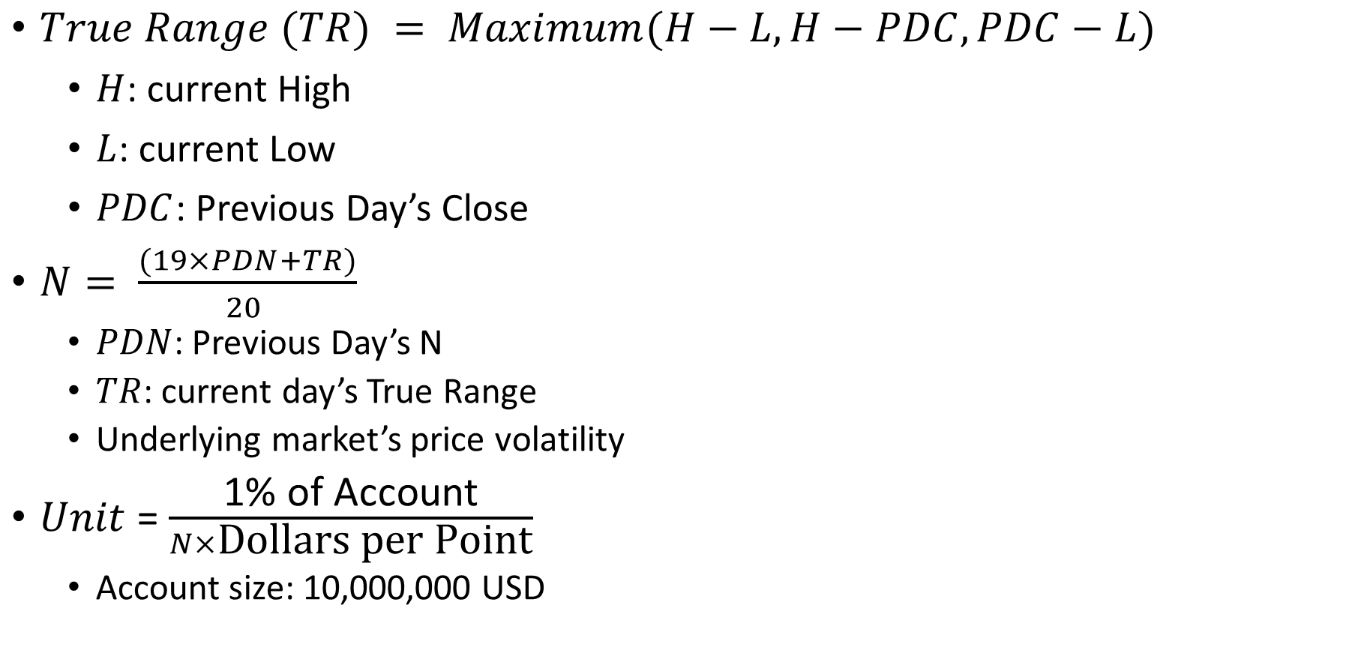
Position Sizing
$True Range (TR) = Maximum(H−L, H−PDC, PDC−L)$
$H$: current High
$L$: current Low
$PDC$: Previous Day’s Close
$N= \frac{(19×PDN+TR)}{20 }$
$PDN$: Previous Day’s N
$TR$: current day’s True Range
Underlying market’s price volatility
$Unit$ = $\frac{\text{1\% }\text{of} \text{Account}}{N×\text{Dollars} \text{per} \text{Point}}$
Account size: 10,000,000 USD

Slide 4
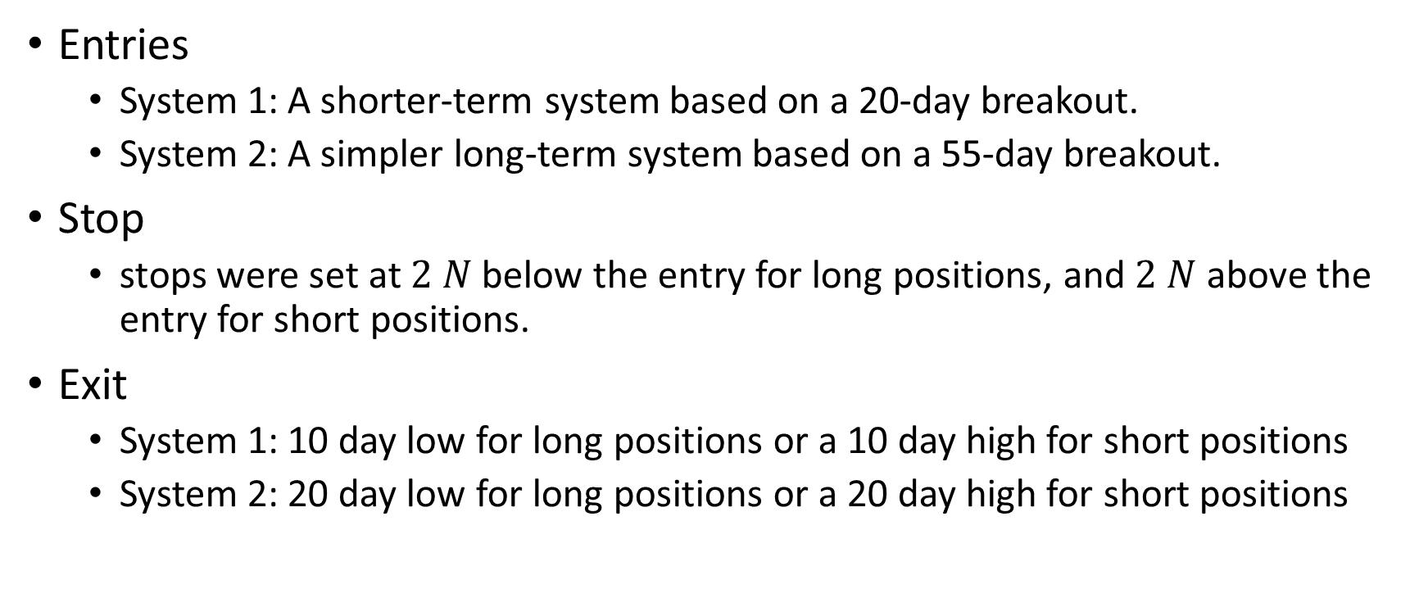
Rules
Entries
System 1: A shorter-term system based on a 20-day breakout.
System 2: A simpler long-term system based on a 55-day breakout.
Stop
stops were set at $2 N$ below the entry for long positions, and $2 N$ above the entry for short positions.
Exit
System 1: 10 day low for long positions or a 10 day high for short positions
System 2: 20 day low for long positions or a 20 day high for short positions

Slide 5
Experiment results
Standard parameters
code | Start time | End time | Annualized rate of return | System 1 |  |  | System 2 |  |  | volatility | sharpe ratio | holding period
 |  |  |  | transactions | trading interval | odds | transactions | trading interval | odds
AUDUSD | 15-Apr-02 | 31-Jan-20 | 3.49 | 127 | 36.57 | 37.80 | 68 | 68.31 | 32.35 | 0.008150 | 0.33 | 15.30
EURUSD | 15-Apr-02 | 31-Jan-20 | 4.00 | 127 | 36.57 | 35.43 | 66 | 70.38 | 34.85 | 0.008432 | 0.36 | 14.90
GBPUSD | 15-Apr-02 | 31-Jan-20 | -1.25 | 146 | 31.82 | 28.08 | 76 | 61.12 | 27.63 | 0.008881 | -0.02 | 13.22
NZDUSD | 15-Apr-02 | 31-Jan-20 | 3.17 | 124 | 37.46 | 37.10 | 65 | 71.46 | 36.92 | 0.008067 | 0.31 | 16.14
USDCAD | 15-Apr-02 | 31-Jan-20 | 0.13 | 129 | 36.01 | 31.01 | 68 | 68.31 | 32.35 | 0.007949 | 0.07 | 14.54
USDCHF | 15-Apr-02 | 31-Jan-20 | -2.77 | 134 | 34.66 | 33.58 | 70 | 66.36 | 32.86 | 0.010788 | -0.06 | 13.70
USDJPY | 15-Apr-02 | 31-Jan-20 | 2.08 | 137 | 33.91 | 32.85 | 65 | 71.46 | 33.85 | 0.008974 | 0.22 | 13.50
USDNOK | 15-Apr-02 | 31-Jan-20 | 4.22 | 122 | 38.07 | 37.70 | 70 | 66.36 | 34.29 | 0.008943 | 0.36 | 15.50
USDSEK | 15-Apr-02 | 31-Jan-20 | 1.82 | 133 | 34.92 | 34.59 | 67 | 69.33 | 35.82 | 0.008025 | 0.21 | 14.65
USDBRL | 12-Apr-02 | 31-Jan-20 | 7.83 | 124 | 37.46 | 34.68 | 65 | 71.46 | 33.85 | 0.012354 | 0.48 | 15.84
USDCLP | 12-Apr-02 | 31-Jan-20 | 8.97 | 133 | 34.92 | 37.59 | 61 | 76.15 | 42.62 | 0.010223 | 0.61 | 15.27
USDCOP | 11-Apr-02 | 31-Jan-20 | 10.55 | 109 | 42.61 | 48.62 | 65 | 71.46 | 41.54 | 0.009362 | 0.75 | 17.66
USDCZK | 12-Apr-02 | 31-Jan-20 | 2.60 | 120 | 38.71 | 40.83 | 69 | 67.32 | 39.13 | 0.007619 | 0.27 | 16.26
USDHUF | 12-Apr-02 | 31-Jan-20 | -0.28 | 132 | 35.19 | 31.06 | 61 | 76.15 | 39.34 | 0.007789 | 0.04 | 14.37
USDILS | 11-Apr-02 | 31-Jan-20 | 4.43 | 120 | 38.71 | 43.33 | 59 | 78.73 | 45.76 | 0.007471 | 0.43 | 17.11
USDINR | 15-Apr-02 | 31-Jan-20 | 10.38 | 105 | 44.24 | 40.00 | 53 | 87.64 | 49.06 | 0.009453 | 0.74 | 19.62
USDKRW | 11-Apr-02 | 31-Jan-20 | 4.29 | 123 | 37.76 | 34.96 | 69 | 67.32 | 27.54 | 0.011934 | 0.32 | 14.96
USDMXN | 12-Apr-02 | 31-Jan-20 | 1.24 | 129 | 36.01 | 35.66 | 60 | 77.42 | 35.00 | 0.009561 | 0.16 | 14.80
USDMYR | 15-Apr-02 | 31-Jan-20 | 11.87 | 101 | 45.99 | 38.61 | 53 | 87.64 | 45.28 | 0.010210 | 0.78 | 16.86
USDPHP | 12-Apr-02 | 31-Jan-20 | 0.73 | 103 | 45.10 | 35.92 | 55 | 84.45 | 41.82 | 0.006470 | 0.12 | 19.02
USDPLN | 15-Apr-02 | 31-Jan-20 | 1.33 | 127 | 36.57 | 34.65 | 66 | 70.38 | 31.82 | 0.008304 | 0.17 | 15.19
USDRON | 12-Apr-02 | 31-Jan-20 | 1.39 | 113 | 41.11 | 31.86 | 65 | 71.46 | 32.31 | 0.008035 | 0.17 | 16.45
USDSGD | 15-Apr-02 | 31-Jan-20 | 4.83 | 121 | 38.39 | 41.32 | 58 | 80.09 | 36.21 | 0.008137 | 0.43 | 17.85
USDTHB | 12-Apr-02 | 31-Jan-20 | 14.51 | 80 | 58.06 | 55.00 | 52 | 89.33 | 53.85 | 0.009974 | 0.94 | 25.38
USDTRY | 12-Apr-02 | 31-Jan-20 | 3.95 | 120 | 38.71 | 38.33 | 67 | 69.33 | 32.84 | 0.010276 | 0.32 | 15.59
USDTWD | 19-Apr-02 | 31-Jan-20 | 13.47 | 86 | 54.01 | 46.51 | 49 | 94.80 | 59.18 | 0.008705 | 0.99 | 23.19
USDZAR | 12-Apr-02 | 31-Jan-20 | -1.88 | 131 | 35.46 | 30.53 | 68 | 68.31 | 27.94 | 0.008627 | -0.07 | 14.00

Slide 6
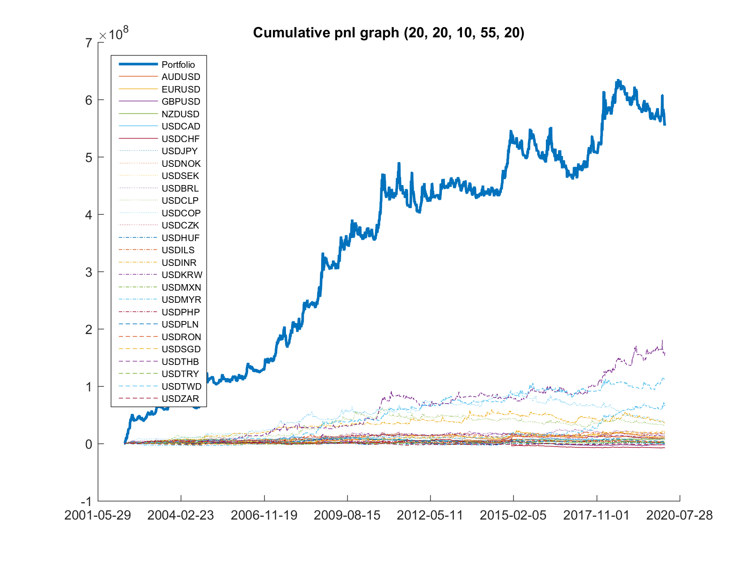
Experiment results
Standard parameters
Portfolio
Start time | 11-Apr-02
End time | 31-Jan-20
Volatility | 0.0128
Sharpe ratio | 1.1713
Holding period | 16.3281

Slide 7
Comparison of different parameter
Para. | Volatility | Sharpe ratio | Holding period
5_20_10_55_20 | 4122.966 | 0.987453 | 16.80902
10_20_10_55_20 | 5066.899 | 0.950191 | 16.56179
20_10_10_55_20 | 2856.57 | 0.758353 | 16.08477
20_20_5_55_20 | 2647.228 | 0.803126 | 12.34572
20_20_10_45_20 | 2947.57 | 0.737183 | 16.45861
20_20_10_55_10 | 2555.676 | 0.765443 | 13.60866
20_20_10_55_20 (standard) | 2846.839 | 0.730259 | 16.32812
20_20_10_55_30 | 2742.81 | 0.646477 | 17.97544
20_20_10_65_20 | 2650.903 | 0.697803 | 16.1293
20_20_20_55_20 | 2862.826 | 0.716343 | 21.11727
20_30_10_55_20 | 2693.636 | 0.738514 | 16.61336
30_20_10_55_20 | 2768.807 | 0.725916 | 16.38738
[volatility smoothing, sys1 entries, sys1 exits, sys2 entries, sys2 exits]

Slide 8
Comparison of different parameter
Para. | Volatility | Sharpe ratio | Holding period
05_20_10_55_20 | 4122.9660 | 0.9875 | 16.8090
10_20_10_55_20 | 5066.8990 | 0.9502 | 16.5618
20_10_10_55_20 | 2856.5700 | 0.7584 | 16.0848
20_20_05_55_20 | 2647.2280 | 0.8031 | 12.3457
20_20_10_45_20 | 2947.5700 | 0.7372 | 16.4586
20_20_10_55_10 | 2555.6760 | 0.7654 | 13.6087
20_20_10_55_20 (standard) | 2846.8390 | 0.7303 | 16.3281
20_20_10_55_30 | 2742.8100 | 0.6465 | 17.9754
20_20_10_65_20 | 2650.9030 | 0.6978 | 16.1293
20_20_20_55_20 | 2862.8260 | 0.7163 | 21.1173
20_30_10_55_20 | 2693.6360 | 0.7385 | 16.6134
30_20_10_55_20 | 2768.8070 | 0.7259 | 16.3874
[volatility smoothing, sys1 entries, sys1 exits, sys2 entries, sys2 exits]

Slide 9
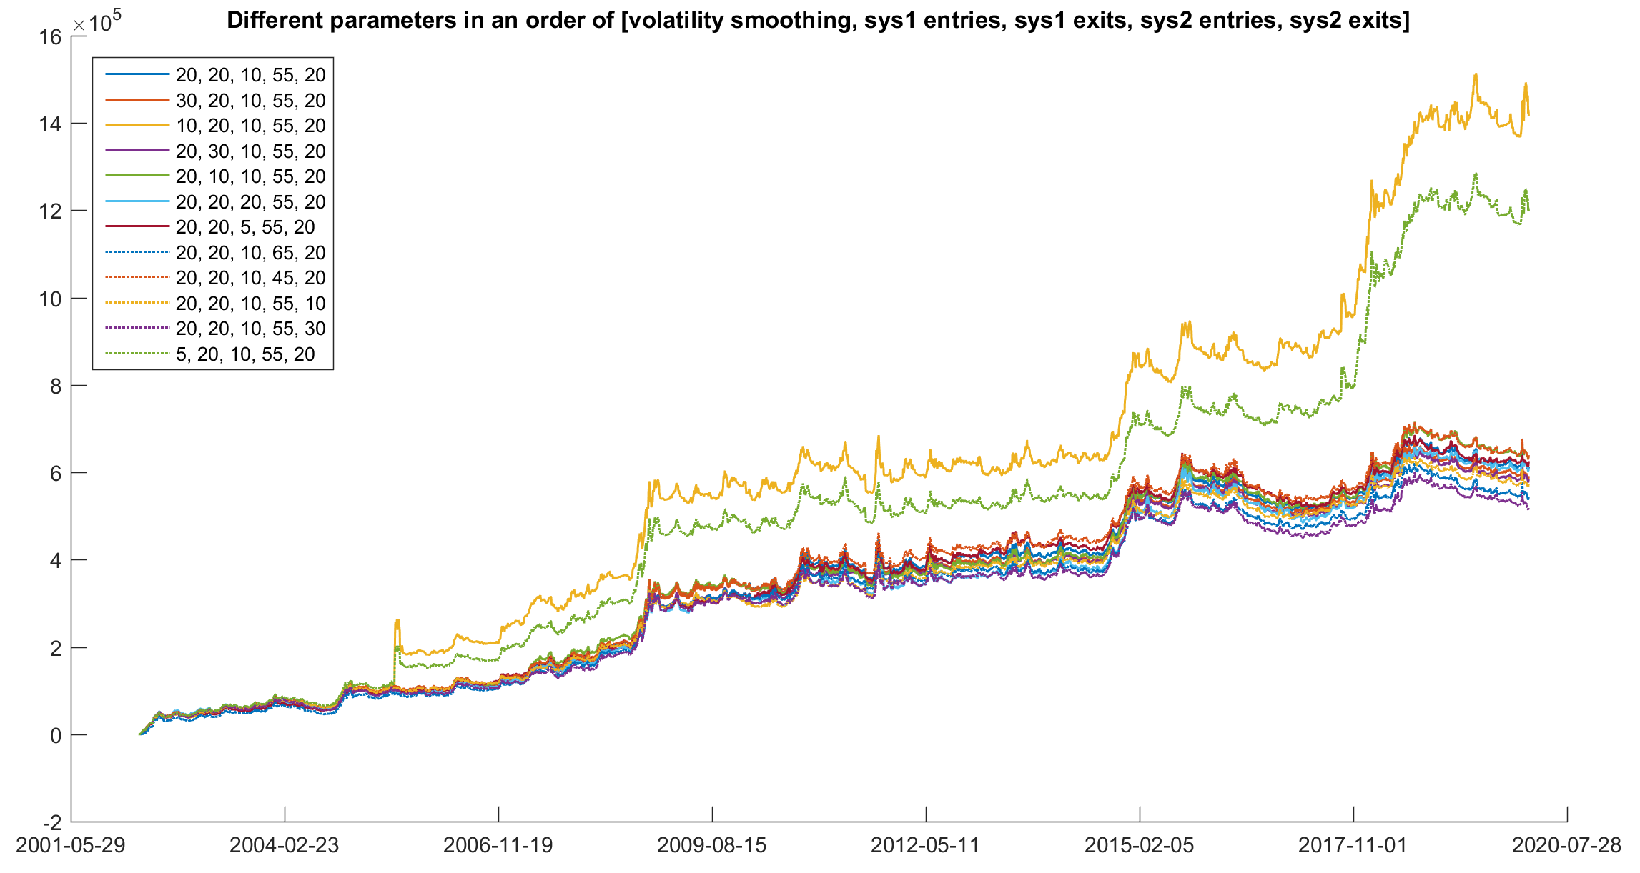
Pnl using different parameter

Slide 10
code | Start time | End time | Annualized rate of return | Syetem 1 |  |  | System2 |  |  | volatility | sharpe ratio | holding period
 |  |  |  | transactions | trading interval | odds | transactions | trading interval | odds
AUDUSD | 15-Apr-02 | 31-Jan-20 | 3.168804 | 125 | 37.16 | 39.20 | 68 | 68.31 | 32.35 | 0.0080 | 0.31 | 15.44
EURUSD | 15-Apr-02 | 31-Jan-20 | 3.489216 | 128 | 36.29 | 35.16 | 66 | 70.38 | 34.85 | 0.0083 | 0.33 | 14.73
GBPUSD | 15-Apr-02 | 31-Jan-20 | -0.9041 | 145 | 32.03 | 28.28 | 76 | 61.12 | 27.63 | 0.0088 | 0.00 | 13.31
NZDUSD | 15-Apr-02 | 31-Jan-20 | 3.792271 | 124 | 37.46 | 37.10 | 64 | 72.58 | 37.50 | 0.0082 | 0.35 | 16.20
USDCAD | 15-Apr-02 | 31-Jan-20 | 0.403908 | 129 | 36.01 | 31.01 | 67 | 69.33 | 34.33 | 0.0079 | 0.09 | 14.77
USDCHF | 15-Apr-02 | 31-Jan-20 | -2.83693 | 133 | 34.92 | 33.83 | 70 | 66.36 | 31.43 | 0.0107 | -0.07 | 13.83
USDJPY | 15-Apr-02 | 31-Jan-20 | 1.443202 | 137 | 33.91 | 32.85 | 66 | 70.38 | 34.85 | 0.0087 | 0.17 | 13.46
USDNOK | 15-Apr-02 | 31-Jan-20 | 4.74682 | 121 | 38.39 | 38.02 | 70 | 66.36 | 34.29 | 0.0088 | 0.40 | 15.65
USDSEK | 15-Apr-02 | 31-Jan-20 | 1.963339 | 133 | 34.92 | 34.59 | 67 | 69.33 | 35.82 | 0.0080 | 0.22 | 14.75
USDBRL | 12-Apr-02 | 31-Jan-20 | 7.910856 | 123 | 37.76 | 34.96 | 65 | 71.46 | 33.85 | 0.0121 | 0.49 | 15.93
USDCLP | 12-Apr-02 | 31-Jan-20 | 9.280176 | 132 | 35.19 | 37.88 | 61 | 76.15 | 42.62 | 0.0102 | 0.63 | 15.37
USDCOP | 11-Apr-02 | 31-Jan-20 | 11.96776 | 109 | 42.61 | 48.62 | 64 | 72.58 | 42.19 | 0.0097 | 0.82 | 17.53
USDCZK | 12-Apr-02 | 31-Jan-20 | 3.497496 | 118 | 39.36 | 40.68 | 69 | 67.32 | 39.13 | 0.0077 | 0.34 | 16.43
USDHUF | 12-Apr-02 | 31-Jan-20 | 0.299185 | 132 | 35.19 | 31.06 | 59 | 78.73 | 38.98 | 0.0078 | 0.09 | 14.73
USDILS | 11-Apr-02 | 31-Jan-20 | 4.363472 | 119 | 39.03 | 43.70 | 59 | 78.73 | 45.76 | 0.0075 | 0.42 | 17.26
USDINR | 15-Apr-02 | 31-Jan-20 | 10.37311 | 105 | 44.24 | 40.00 | 53 | 87.64 | 49.06 | 0.0093 | 0.74 | 19.64
USDKRW | 11-Apr-02 | 31-Jan-20 | 4.046958 | 124 | 37.46 | 33.87 | 67 | 69.33 | 29.85 | 0.0116 | 0.31 | 15.10
USDMXN | 12-Apr-02 | 31-Jan-20 | 1.584175 | 129 | 36.01 | 35.66 | 59 | 78.73 | 35.59 | 0.0095 | 0.18 | 15.00
USDMYR | 15-Apr-02 | 31-Jan-20 | 27.24039 | 100 | 46.45 | 39.00 | 52 | 89.33 | 44.23 | 0.1524 | 0.28 | 19.31
USDPHP | 12-Apr-02 | 31-Jan-20 | 0.709665 | 103 | 45.10 | 35.92 | 55 | 84.45 | 41.82 | 0.0064 | 0.12 | 19.09
USDPLN | 15-Apr-02 | 31-Jan-20 | 1.5572 | 125 | 37.16 | 35.20 | 66 | 70.38 | 31.82 | 0.0082 | 0.18 | 15.39
USDRON | 12-Apr-02 | 31-Jan-20 | 1.856299 | 110 | 42.23 | 33.64 | 63 | 73.73 | 34.92 | 0.0079 | 0.21 | 17.07
USDSGD | 15-Apr-02 | 31-Jan-20 | 4.79095 | 122 | 38.07 | 40.16 | 59 | 78.73 | 35.59 | 0.0081 | 0.43 | 17.63
USDTHB | 12-Apr-02 | 31-Jan-20 | 13.62716 | 80 | 58.06 | 56.25 | 52 | 89.33 | 53.85 | 0.0100 | 0.89 | 25.49
USDTRY | 12-Apr-02 | 31-Jan-20 | 4.448049 | 118 | 39.36 | 38.98 | 66 | 70.38 | 33.33 | 0.0102 | 0.35 | 15.93
USDTWD | 19-Apr-02 | 31-Jan-20 | 14.00399 | 85 | 54.65 | 48.24 | 49 | 94.80 | 59.18 | 0.0087 | 1.03 | 23.92
USDZAR | 12-Apr-02 | 31-Jan-20 | -1.70767 | 130 | 35.73 | 30.77 | 67 | 69.33 | 28.36 | 0.0086 | -0.06 | 14.20

Slide 11
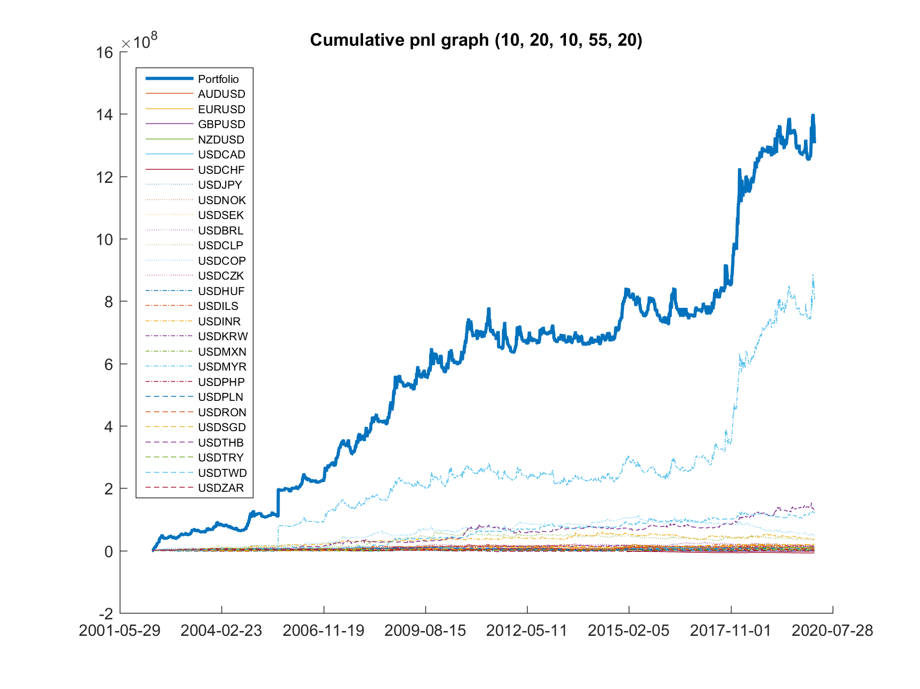

Slide 12
